Slide 1
ByPass Ads
Your time is valuable.
Notes:
Our team members are Chintan, Phuc, Luca, Lorenzo and Walter.

Slide 2
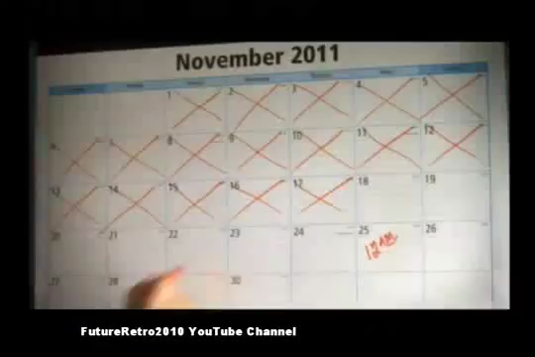


Consumer Interaction
Share ad on:
Use 5 credits to ByPass this Ad
200 credits available
Notes:
The normal web browsing experience is interrupted by online video advertising. We offer a user the ability to pay to bypass a video advertisement. You’ll notice we have provided 200 credits to use before they even create an account.

Slide 3

Consumer Interaction
Share ad on:
View ByPass Ads account
195 credits available
Notes:
After an ad is bypassed the user may still see the logo of the advertiser. They can still share the ad. And they can view their new account balance, or click to view their account in a new window.

Slide 4
Ben Jamin
Ben Jamin works a 9-5 job. He has time in the morning when he gets to work. He reads the news and surfs the web for the first half hour of the business day. During this time he doesn’t care how many video ads he has to sit through. At the end of the day Ben browses the internet for the last five minutes as he waits for the train home. He is more inclined to bypass ads at the end of the day when time is more important to him than the small amount of money it costs.
Notes:
This is a user persona. It’s intended to show the user who will help use our product. Without the user we don’t have any user bypass reports.

Slide 5
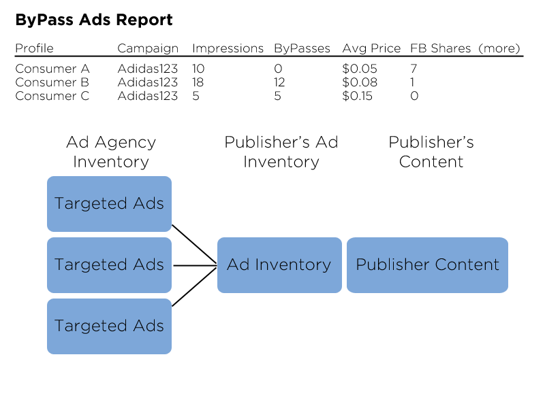
The Advertiser Report
  ByPass Ads targets brand awareness, likelihood to recommend, favorability
Notes:
Once we have user activity history we can begin to package a report. Possible metrics include bypass to impression ratio. Average price paid to bypass. And number of shares of an ad by a person who has bypassed the ad.

Slide 6
The Advertiser Product
ByPass Ads offers a product with the following features for web marketers in the video advertising segment:
Transaction history
  Available advertisement information (ad campaign, ad displayed, the value offered to bypass, whether it was bypassed, the value paid for bypass, time of transaction, time elapsed before bypass)
  Available user information (user id, demographic data, past bypass transaction history, past purchase history)
Cross domain metrics
  Brand awareness, Purchase intent, Likelihood to recommend, Favorability
Notes:
What are we selling? We’re selling a supplemental analytics report. The goal is to provide brand marketers more of what they’re looking for. Current analytics are insufficient. They are based on segmentation of the market at a higher level than we offer.

Slide 7
Early Market Strategy
Build a simplified publishing platform (Entry Point)
  Prove the technology, start initial beta testing
Sell to advertisers and evolve the product (Beachhead)
  Provide our script, graphic layers and API
  Create transaction history and refine the reports
Start licensing to intermediaries and platforms (Market Development)
  Embed our technology
  Sell our reports
Notes:
We want to own our product completely in the beginning. This will allow us to keep driving progress without relying on others.
To get started we plan to build a simplified publishing platform.
We can prove the technology works and start beta testing.
Initial data will dictate when we can start selling to advertisers, our beachhead market.
As we grow we will continue to beta test and collect valuable feedback.
Eventually we want to work with larger partners to expand our market size.
Traction will create greater reach and brand identity.
We will license to publishing partners to create opportunities for integration of our product.
We will license to intermediaries to integrate with existing metrics and strategies (e.g. with TubeMogul).

Slide 8
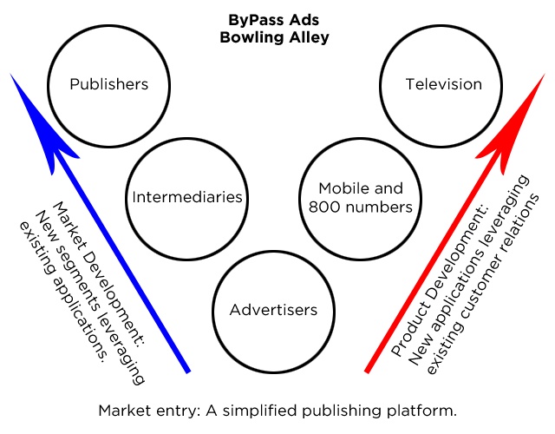
The Bowling Alley
Notes:
We want to own our product completely in the beginning. This will allow us to keep driving progress without relying on others.
To get started we plan to build a simplified publishing platform.
We can prove the technology works and start beta testing.
Initial data will dictate when we can start selling to advertisers, our beachhead market.
As we grow we will continue to beta test and collect valuable feedback.
Eventually we want to work with larger partners to expand our market size.
Traction will create greater reach and brand identity.
We will license to publishing partners to create opportunities for integration of our product.
We will license to intermediaries to integrate with existing metrics and strategies (e.g. with TubeMogul).

Slide 9
Innovation
Product innovation
Business model innovation
Notes:
We believe ByPass Ads is a product innovation, but we hope to come a business model innovation. We hope to change the way publishers approach advertising.

Slide 10
Right Side of History
Internet advertising
  Online advertising is a strong business
  Online video advertising is growing (YoY and high CPM)
Microtransactions
  eWallets distribute payment gateway fees
  Technology supports cookies and asynchronous page loads
Publishers seek new revenue streams
  Display ads CPM is dropping
  Content is becoming a commodity
Notes:
Our research shows that we’re on the right side of history.

Slide 11
Thank You
Notes:
Backup slides follow

Slide 12
Beta? Data? Both!
Is 5 cents to bypass the right amount?
Is 2 cents margin over an ad slot price the right amount?
Will credits work better than cents?
Will users bypass if they're given credits?
Will users bypass if they have to create accounts?
Will advertisers forgo brand exposure to be sure they're promoting to people who want to see their ads?
Will advertisers get anything out of their bypass ads metrics?
How long will it take before transactions recorded become valuable information?
Notes:
Don’t spend much time on this slide. Just shows that we want to beta test.

Slide 13
Analogs and Antilogs
Analogs
  Payment System (PayPal)
  Micropayments (FastTrak, Apple)
  Skipping ads (YouTube)
  Metrics (TubeMogul)
Antilogs
  Payment System (common web stores)
  Skipping Ads (AdChoices)
  Metrics (Spammer cookies)

Slide 14
User ByPass Workflow
1. User browses the web
2. User selects content
  An ad slot is available for ad placement
  An ad slot is filled from ad inventory or auctioned
3. User chooses to bypass the video ad
  The ad placement is overridden
  Content is displayed
4. User views desired content

Slide 15
Service Features for Advertisers
Embeddable Script
  A small amount of code downloadable from ByPass Ads and embeddable into the advertising platform
API
  A software system operated by ByPass Ads
  Store and process user transactions and related data
Advertiser Accounts
  Campaign metrics
  Audience metrics

Slide 16
Faque Company
Faque Company has an established brand. They advertise with a limited marketing budget and want to maximize their ROI. Faque has been advertising on television because the return is predictable, albeit low. They have been interested in online video advertising but they have held out until now. With ByPass Ads they are convinced they can get a better understanding of their brand awareness and who is likely to recommend their products to other people.
Notes:
Persona for the advertiser.

Slide 17
Balast Media
Balast Media is a small online ad platform. They provide analytics to advertisers and offer ad placement on large content publishing platforms. Balast has a desire to increase their competitive advantage by including the best metrics available. By including ByPass Ads they have both an additional feature to offer, as well as the metrics that go along with it.
Notes:
Persona for the intermediary.

Slide 18
Value Proposition 1
The value proposition for the consumer.
For video content viewers who are dissatisfied with repeatedly viewing the same ads, our product is a single sign-on service that provides the option of paying to bypass ads.
Unlike premium account subscriptions that charge an upfront cost for ad-free viewing, our service enables a-la-carte advertisement bypassing at a significantly lower cost.
Notes:
I need this slide in because I can’t memorize it.

Slide 19
The Consumer Product
ByPass Ads offers a product with the following features for consumers of web video content:
A financial transaction account (eWallet)
  Add monetary value to an account using a credit card, checking account, PayPal and Facebook Credits
  View transaction history (ads bypassed, funds transacted)
Single sign-on
Free credits to get started
Notes:
We need users to begin using our product so that we can create reports based on their activity. We would like to make a margin on every bypass. Beta testing will show if this is possible.

Slide 20
Value Proposition 2
The value proposition for the advertiser.
For brand marketers who are dissatisfied with their advertising efficiency our product is an advertisement bypass service that provides feedback on brand awareness, likelihood to recommend, and favorability.
Unlike conventional video advertising where excessive spending often leads to diminishing returns, our service helps optimize advertising expenditure.
Notes:
Our value proposition is supported by research that shows brand advertisers are less likely to advertise online because of the risk involved for a less certain ROI.

Slide 21
Innovation
Product innovation
  ByPass Ads is an extension of the existing behavioral analytics and ad targeting model
Business model innovation
  We believe ByPass Ads has the potential to change the way publishers approach advertising
  Users are paying for their time instead of content
  Improves the traditional web browsing experience
Notes:
We believe ByPass Ads is a product innovation, but we hope to come a business model innovation. We hope to change the way publishers approach advertising.

